Slide 1
Weekly and Monthly analysis of marketing strategies
- By Satyam Pandey -

Slide 2
Table of contents
01
02
03
04
Introduction
Presentation
Analysis
Conclusion
Introduce our data set and explain, what we are going to do with it.
Here, We are presenting how our data looks like and features of it.
We do analysis of data and create some observations by which we understand it.
Finally, by Analyzing the data, we reached out on some conclusions.

Slide 3
01
Introduction
Welcome to our marketing strategy analysis comparing the effectiveness of Google Ads and Listing Site campaigns.

Slide 4


In this analysis, we explore the data-driven insights obtained from both Google Ads and Listing Site campaigns. By evaluating key metrics such as impressions, clicks, click-through rates (CTR), conversions, and cost per conversion, we aim to understand the strengths and weaknesses of each strategy.
The goal of this analysis is to equip our marketing team with valuable information that will help us optimize our marketing mix, enhance customer engagement, and ultimately drive higher returns on investment. Join us as we uncover the essential findings and recommendations that will shape the future of our marketing efforts.
Let's embark on this journey to unlock the potential of these two marketing strategies and make more strategic decisions moving forward.

Slide 5
02
Presentation
Here, we present our data, explain its features and understand what we conclude with it.

Slide 6
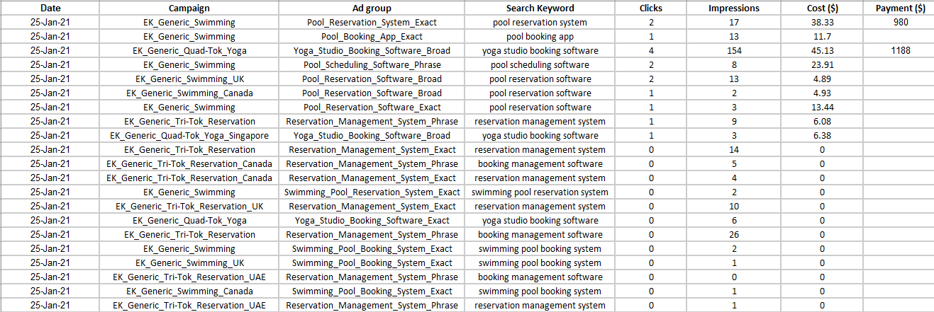
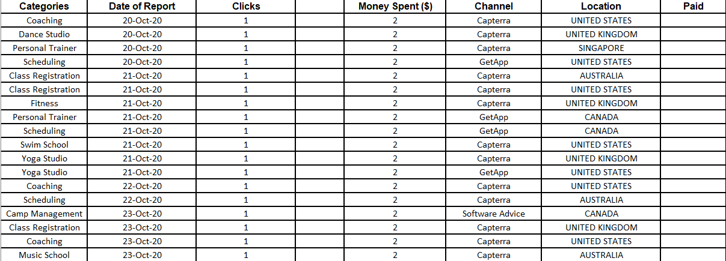
Dataset to be analyzed
Google ads analysis data
Listing site analysis data

Slide 7
Various components of data
Google ads analysis data
Listing site analysis data
Date – Individual day
Campaign – Product
Ad group – Specific group of keyword
Search keyword
Clicks – Number of clicks by user
Impressions – Number of views
Cost – money spend on ads
Payment - Money received
Categories - Products
Date of report – Individual day
Clicks –Number of clicks by user
Money spent – Money spend on ads
Channel – Channel showing ads
Location – Audience engaged
Paid - Money received

Slide 8
03
Analysis of data
After viewing the data and analyzing the columns now, we are ready with the analysis part.

Slide 9
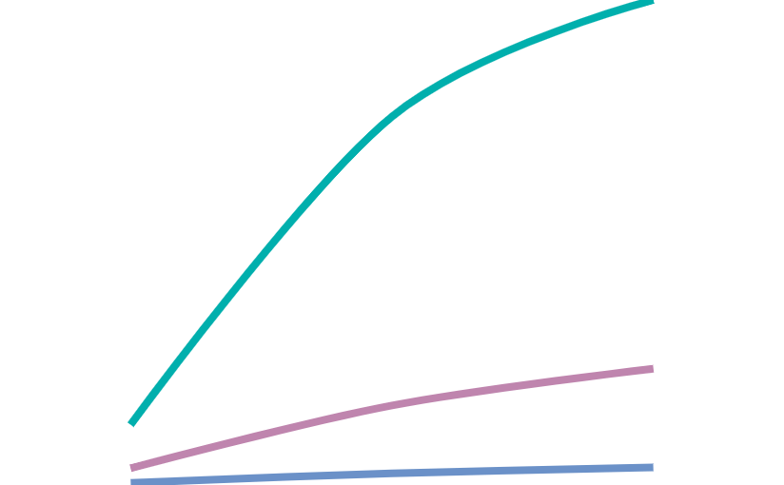
Google ads analysis
Clicks
29.4%
Ek_Generic_Swimming got the highest clicks
Impressions
49.1%
Ek_generic_Quad-Tok_Yoga got the highest impressions
Cost
1 2 3 4 5
29.4%
Ek_generic_Quad-Tok_Yoga got the highest money spend
Months

Slide 10
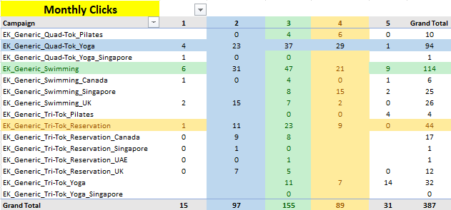
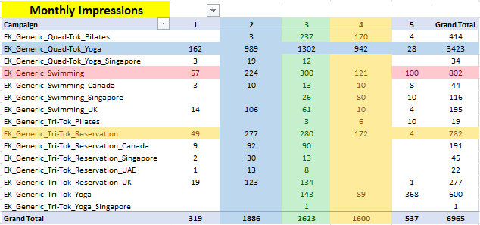
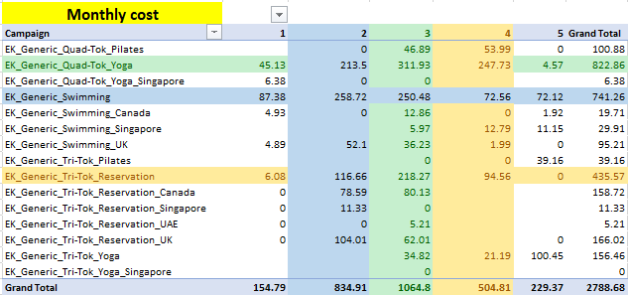
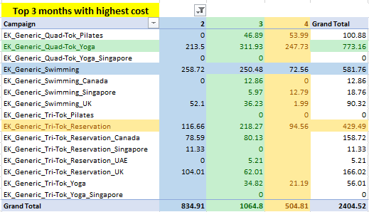
Key pivot for monthly analysis

Slide 11
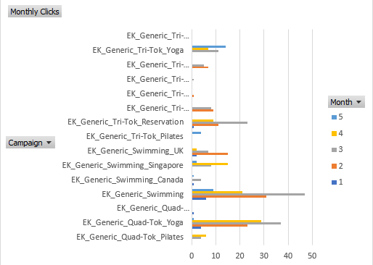
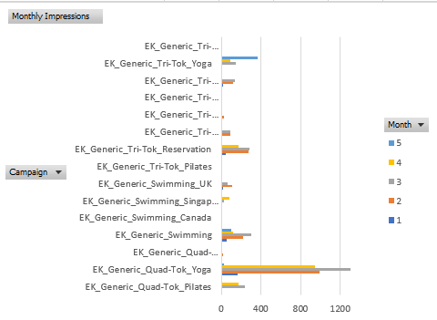
Key pivot charts
Monthly clicks of the campaign
Monthly impressions of the Campaign

Slide 12
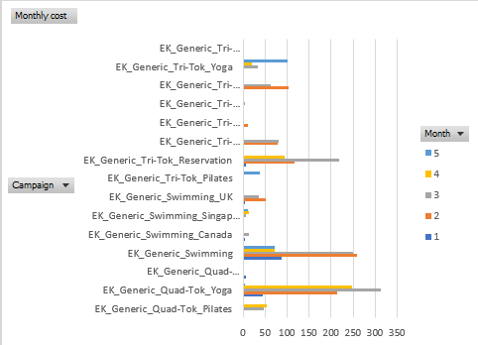
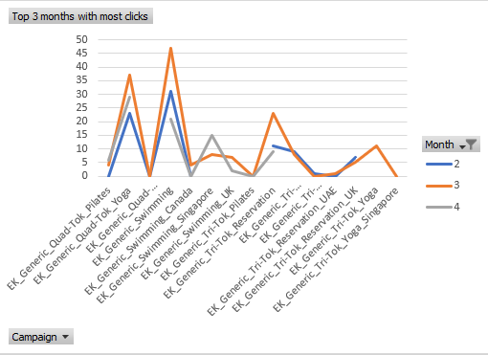
Key Pivot Charts
Monthly Cost spend for Campaign
Top 3 months with highest clicks

Slide 13
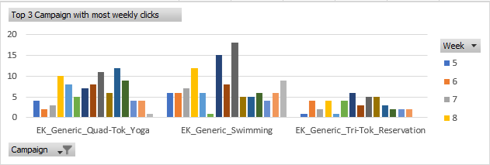
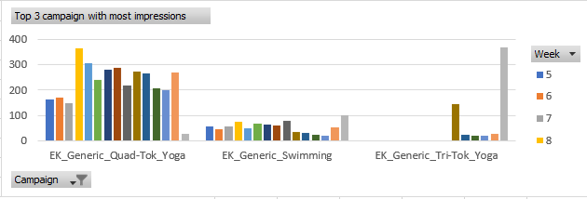
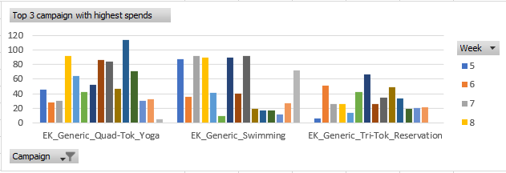
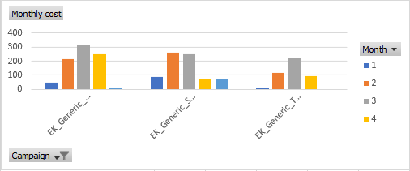
Pivot charts

Slide 14
Inference from google ads analysis
Weekly Stat
Monthly Stat
Ek_Generic_Swimming got the highest clicks in the week.
8th, 13th and the 14th weeks are the weeks where we got the most number clicks and impressions.
Ek_Generic_Quad-tok_Yoga got the highest impressions in the weeks.
Ek_Generic_Quad-tok_Yoga got the highest money spend in weeks
8th, 11th and the 13th weeks are the weeks where we got the most spends of money.
Ek_Generic_Swimming got the highest clicks in the months.
2nd, 3rd and the 4th months are the months where we got the most number Clicks, Impressions and the spend of money.
Ek_Generic_Quad-tok_Yoga got the highest Impressions in the months.
Ek_Generic_Quad-tok_Yoga got the highest spends in the months.

Slide 15
Profitable keyword & Returns
The most profitable keywords are Booking management store, Pool reservation software and Yoga Studio booking store.
The Highest profit was earned by Ek_Generic_Tri-Tok_Reservation followed by Ek_Generic_Swimming and Ek_Generic_Quad-Tok_Yoga with the amount of $3690, $2626 and $1347.
There are most of the campaign who not get the payment because of their minimum spends and impressions.

Slide 16
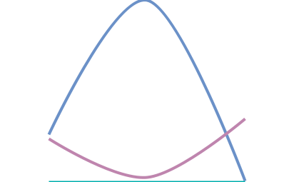
Listing site analysis
Clicks
6.9%
Week 46 got highest clicks for different categories
Paid
27.1%
Week 8 got the highest paid with 6380.
Money Spent
1 2 3 4 5
10.3%
Week 46 got the highest money spent.
Months

Slide 17
Audience demographics
Canada
UK
USA
Highest – 46.9%
High – 19.9%
Medium – 12.2%
Low – 10.7%
Lowest – 10.09%
Singapore
Australia

Slide 18
Most Valuable Categories
 | Scheduling | Reservation | Membership
Spends | $8246 | $5627.75 | $4273.85
Clicks | 1047 | 704 | 482
Paid | $7744 | $4437 | $1788

Slide 19
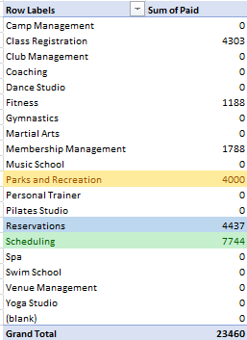
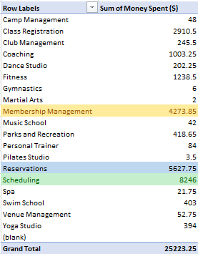
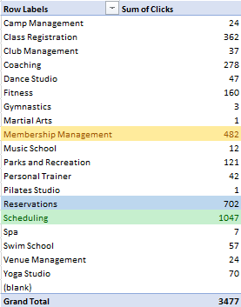
Key pivot tables

Slide 20
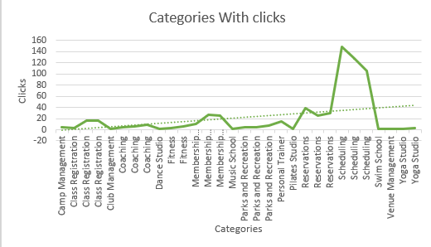
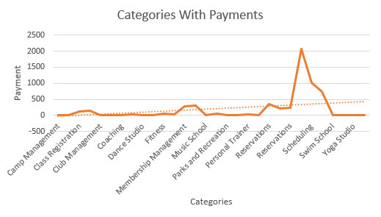
Key Pivot Charts
Categories With Clicks
Categories With Payments

Slide 21
Key Findings
If we spends more on the campaigns there is more profit.
High Impressions helps into high profits.
USA has the highest number of sales.
Scheduling is the most demanding category.

Slide 22
Conclusion
EK_Generic_Swimming Dominates Performance: Among all the campaigns, "EK_Generic_Swimming" emerged as the top performer with the highest number of clicks, impressions, and overall return on investment. This campaign's success highlights the significance of tailoring ad content to specific products or services to resonate effectively with our target audience.
Scheduling Category Drives Success: The "Scheduling" category exhibited remarkable performance, boasting the highest spend, clicks, and return. This result emphasizes the importance of strategically aligning our marketing efforts with specific timeframes and events that resonate well with our customers. Fine-tuning our campaigns within this category can further enhance our overall marketing effectiveness.
Optimization Opportunities: While "EK_Generic_Swimming" and the "Scheduling" category have demonstrated excellent performance, other campaigns may benefit from optimization. Analyzing the top-performing campaigns can provide valuable insights for refining and improving the underperforming ones.

Slide 23
Maximizing Returns: To achieve greater returns on investment, a balanced approach is essential. Allocating resources to well-performing campaigns like "EK_Generic_Swimming" and the "Scheduling" category, while concurrently optimizing lower-performing campaigns, can yield improved overall results.
Data-Driven Decision Making: This analysis underscores the importance of data-driven decision-making in our marketing endeavors. By continuously monitoring and analyzing campaign performance, we can make informed choices, adapt strategies, and capitalize on opportunities as they arise.
If we talk about the comparison between both the data, we can say that the Google ads analysis data is more preferable in terms of analysis because it has all the feature columns which are necessary for the analysis such as Clicks, Impressions, Spends and the returns.
But if we haven’t the Impression column and validated dates then we prefer the listing store analysis it gives us the sorted data with each categories. So, it will helpful for us to analyze it individually.

Slide 24
Recommendations
We have to spend more on some campaign to get high profit.
We have to do a good SEO for the keywords.
Enhance the categories where we achieve more.
Where we experience loss, analyze it and shift it with the profitable one.

Slide 25
Thank you
“If you torture the data long enough, it will confess to anything”
Ronald H. Coase

